Slide 2
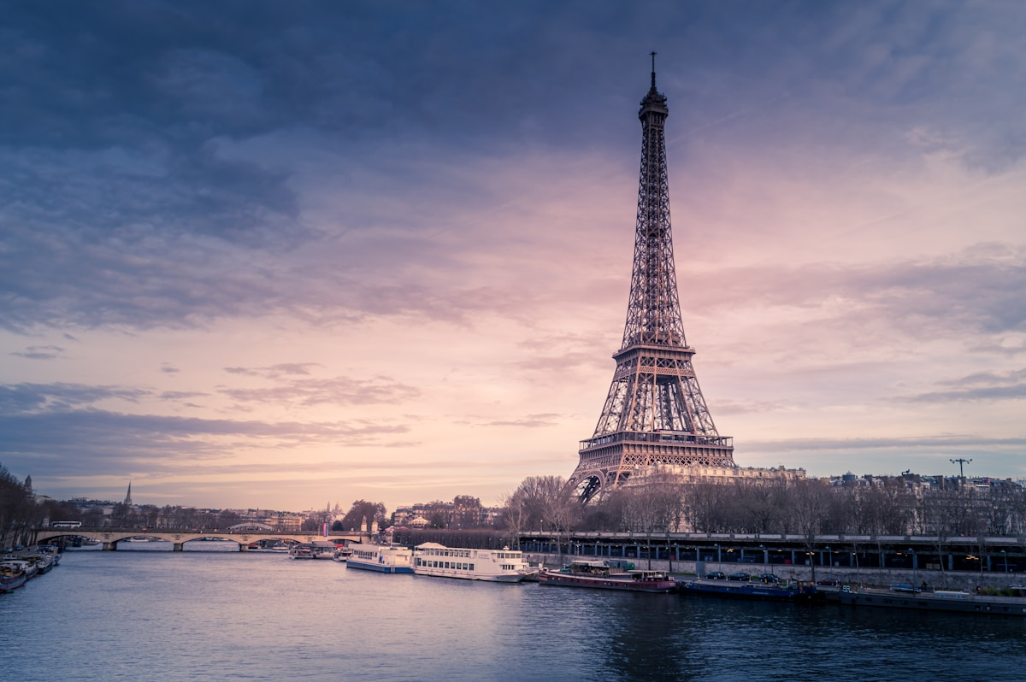
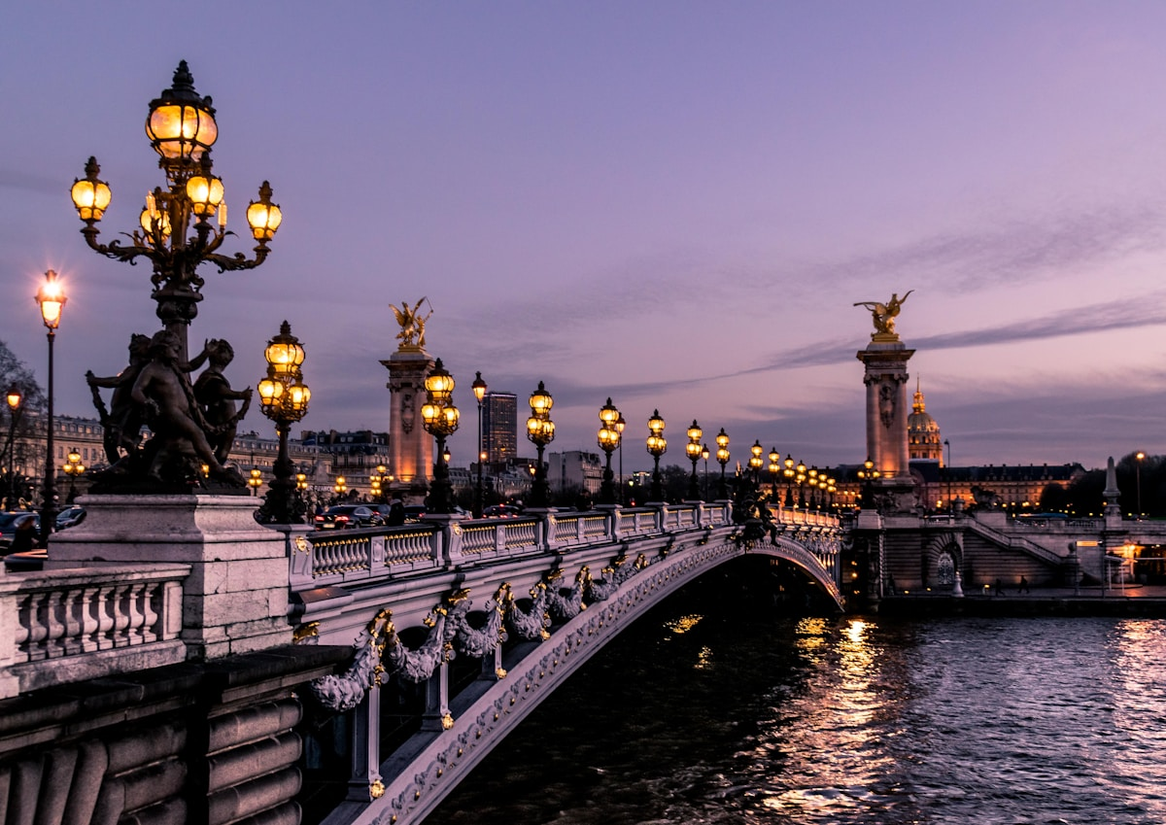
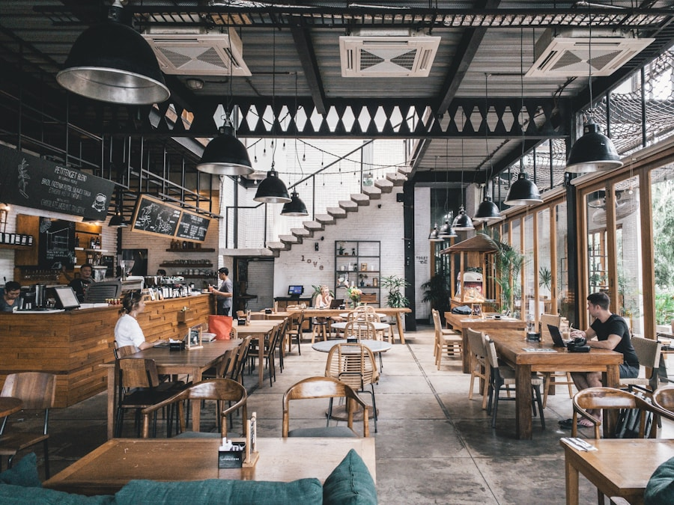
CULTURAL PRESENTATION · 2025
FRANCE · EUROPE
CITY OF LIGHT
CAPITAL OF FRANCE
48°51′N · 2°21′E
PARIS
PARIS
HERITAGE · ART · GASTRONOMY · FASHION · HISTORY
TOUR EIFFEL
CHAMP DE MARS · PARIS
2,000+
2.1M
#1
YEARS OF HISTORY
CITY POPULATION
MOST VISITED CITY
SEINE · ÎLE DE LA CITÉ
PARISIAN CUISINE

Slide 3
02
LOCATION
WHERE
IS IT?
NORTH-CENTRAL FRANCE
SEINE RIVER
48°N · 2°E
CAPITAL CITY
WESTERN EUROPE
ÎLE-DE-FRANCE

Slide 4
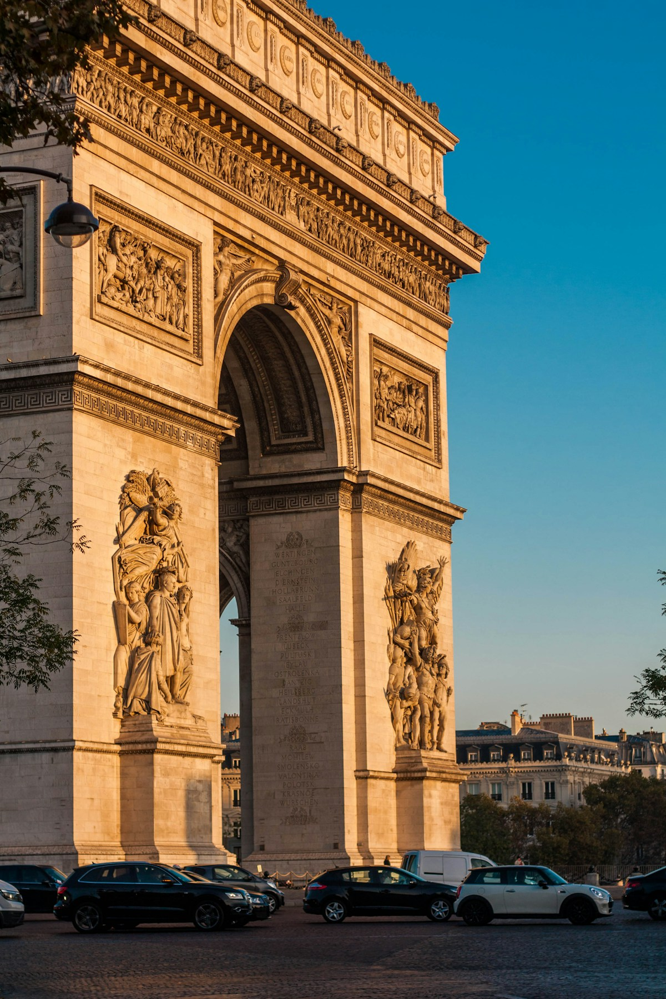
WHY PARIS
WHY I LOVE IT
REASONS
TO LOVE
PARIS
01
ART & ARCHITECTURE
Louvre · Notre-Dame · Haussmann
02
GASTRONOMY & CAFÉ
Bistros · Patisseries · Michelin
03
FASHION & STYLE
P
Haute Couture · Chanel · Savoir-Faire

Slide 5
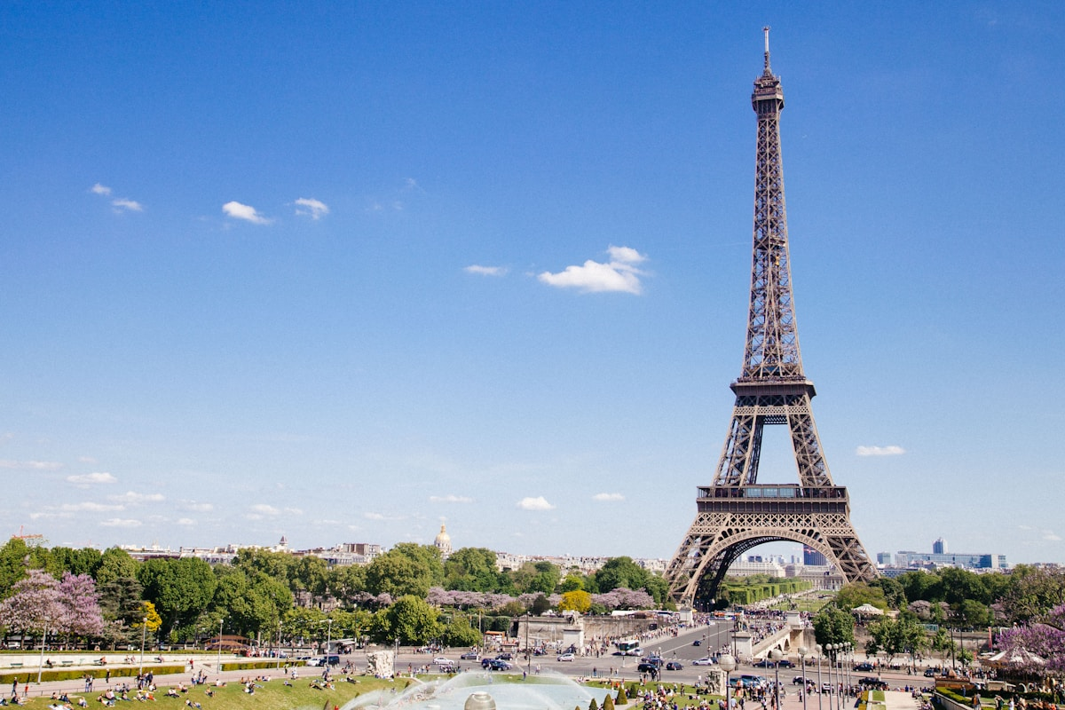
HISTORICAL FUN FACT
Built to
be torn
down
EIFFEL TOWER
1889
TEMPORARY
IRON GIANT
300M TALL
1889
1889
W O R L D ' S F A I R · P A R I S

Slide 6
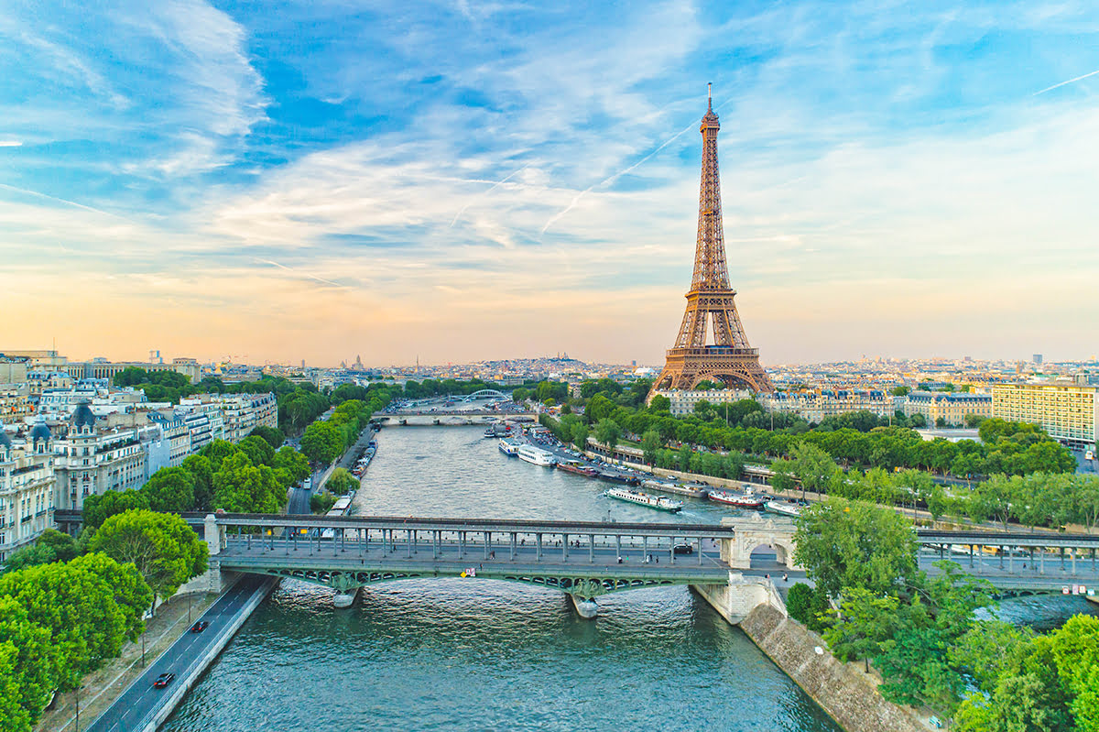
MODERN FUN FACT
#1
100M+
4,500
132
TOURISM
VISITORS / YEAR
RESTAURANTS
MUSEUMS
Most Visited
City · World
Pre-Pandemic
Record
Michelin Star
Capital
City of
Light · Art

Slide 7
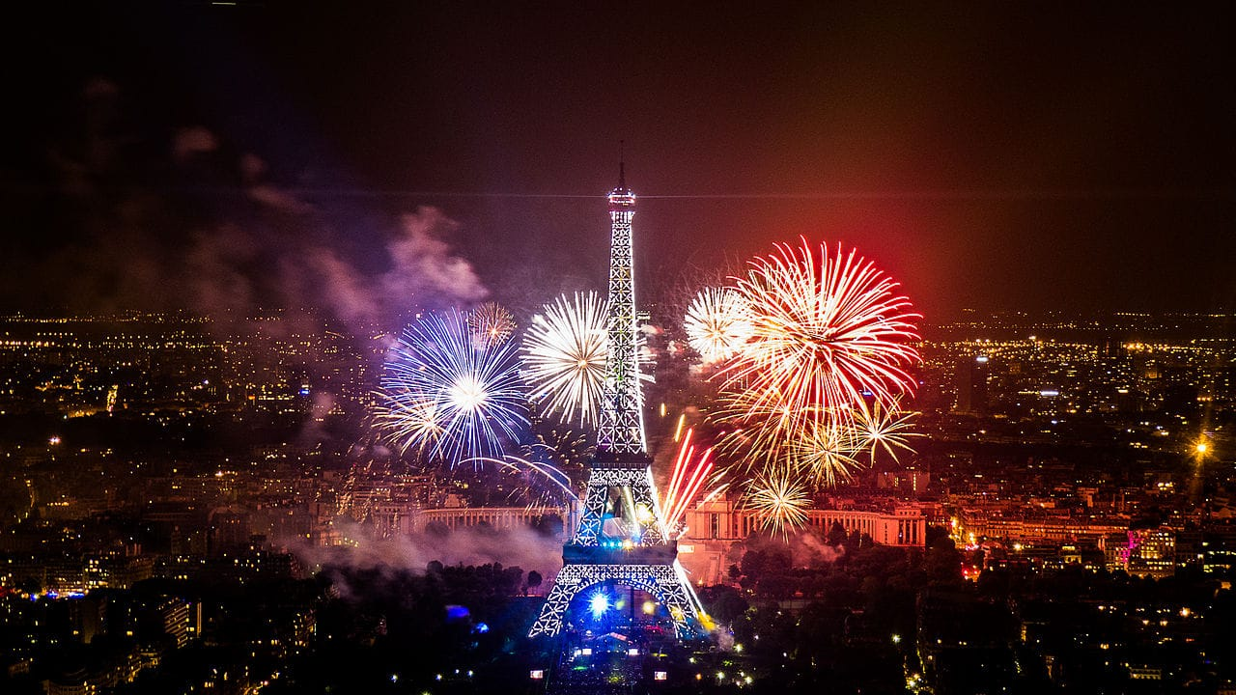
CULTURAL TRADITION
LA
FÊTE
NATIO-
NALE
1789
233
FOUNDED
YEARS OLD
F
FRENCH REVOLUTION
LIVING TRADITION
BASTILLE DAY · JULY 14
NATIONAL UNITY
1789 REVOLUTION
FIREWORKS · PARADE

Slide 8
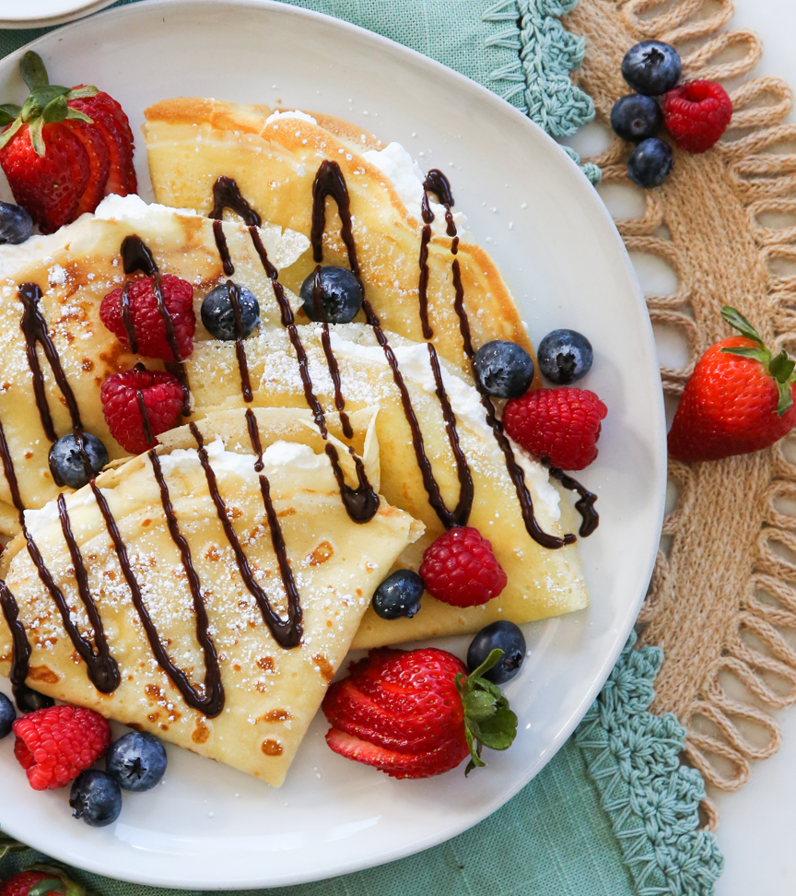
CUISINE · ORIGINS
FOOD & CULTURE
crÊpe
ORIGIN
BRITTANY, FRANCE · 13TH CENTURY
BASE
BUCKWEAT (GALETTE) · WEAT FLOUR
TYPES
SWEER (DESSERT) · SAVORY (GALETTE)
SYMBOL
LA CHANDELEUR · FEB 2ND
1B+
800+
C
EATEN PER YEAR IN FRANCE
YEARS OF HISTORY
ICONIC PARISIAN FOOD

Slide 9
MERCI
CULTURAL PRESENTATION · PARIS
THANK
YOU
HERITAGE · ART · GASTRONOMY · FASHION · HISTORY

